Slide 1
Datacap Custom Export Asset Value Proposition
DBA ISL – Poornima, Ranjeeth and Shashank
18 Feb 2020

Slide 2

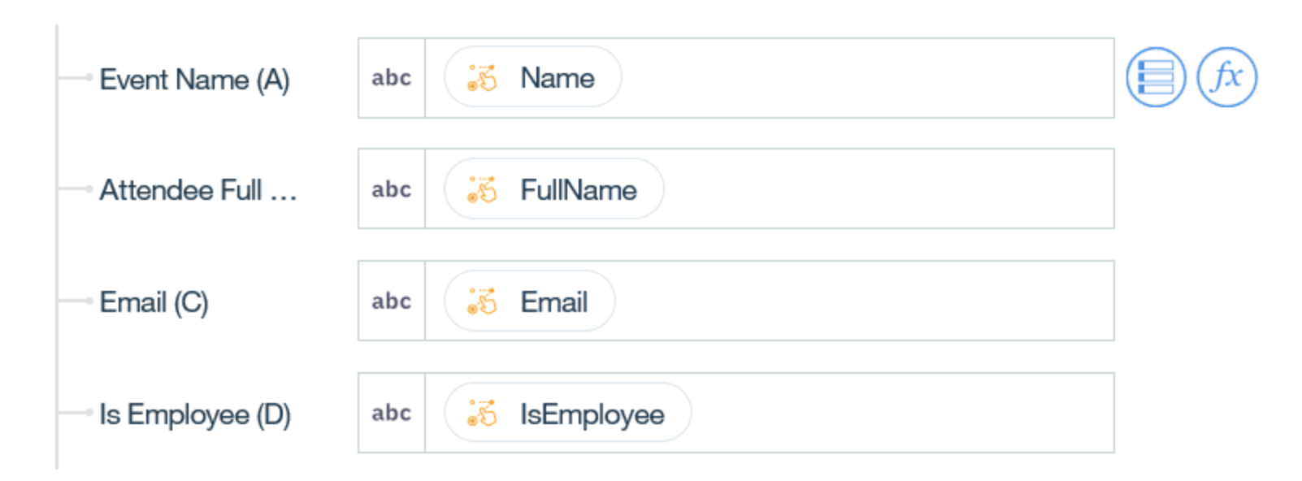
Requirement overview
External systems
DataCap Rest Service
JSON based HTTP APIs for lookup
EDI
IBM App Connect / Preferred
2
5a
5b
---
Custom templates
SmartExport custom action
3
1
4
Custom Action
Trigger on batch
Integration
User interface

Slide 3
Data flow
DataCap SmartExport custom action generates data output in a format that the external system understands
REST API interface exposes these formatted output in the form of APIs
EDI (Example: AppConnect) is configured to map source to target and for pushing the data to the external system
Custom action in DataCap sends an event to EDI when a new DataCap batch is processed
EDI uses the REST API to fetch the data and push it to the external system

Slide 4
Datacap Export – Pain Points
Datacap Out-Of-the-Box (OOTB) XML output contains all the data elements captured from the document that requires post processing and downstream application needs to parse it to retrieve relevant information for further business processing.

Slide 5
Datacap Smart Export Asset – Technical Value proposition
The asset with Smart Export is significant value add in addition to OOTB Datacap XML Output. The Smart Export MVP asset helps Datacap developer to output selective data elements from DCO in the format of user choice currently supported. This from technical side will help during POC, Customer Demo and part of other solution development where selective output in desired format is required

Slide 6
Datacap Smart Export Asset – Business Value proposition
The Smart Export custom action is the first and significant building block in implementing a business solution for scenarios where digital data extracted from documents need to be updated in External Applications like SAP, Sales Force etc. This asset will selectively export the most important data elements from the document, which is of business importance, in a format of choice, as defined by users using predefined templates. Selective export using Smart Export helps reduce data cluttering and reduces integration complexity at the EDI layer by ensuring there are less data elements to work with and thus leading to a simpler integration interface.

Slide 7









MVP Asset overview
CSV/XML
DataCap Proprietary format
Source
Scan
Page ID
Extract
Verify
Export
Destination
Key/Value
Control what is written and in which format
CSV
Custom Export
(Templates)
Tab delimited
Custom

